Slide 1
MANA FOOD
Home Food At Your Door-Step!
Team Members:
Amrutha (63)
Meghana (84)
Sireesha (317)

Slide 2
Problem Statement:
In a fast paced economy we’re all engineers by the day but musicians, dancers, DJs and startup executives by the night. In this struggle to balance reality and dreams, we forget to take care of ourselves. And between all this everyone craves for a little bit of home food staying far away from home. Only the hostellers and bachelors would know the true pain of it.

Slide 3
Solution:
1
Our idea is to make an android application that can deliver home cooked food at your door step.
Anybody can register themselves as a cook.
Once they register all they have to do is put their menu and receive orders.
You can register yourself as a customer and order food.
2
3
4

Slide 4
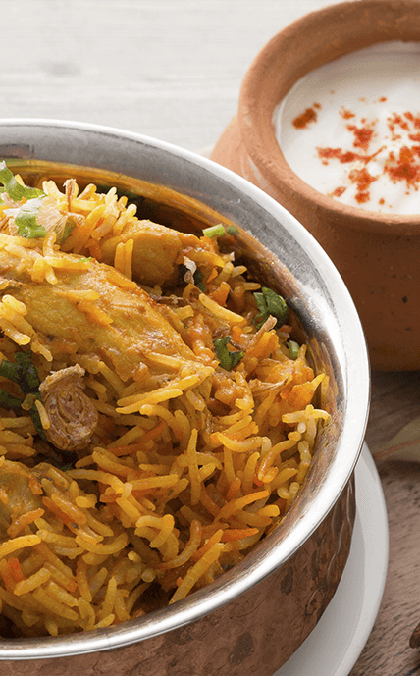
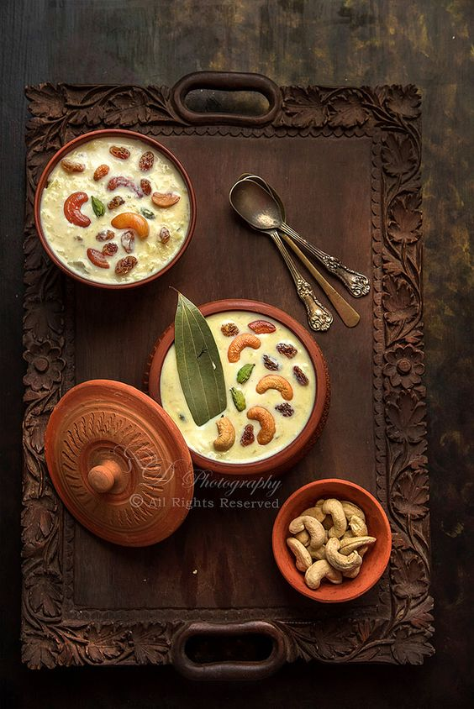
Use cases:
COOK what you can
ORDER what you want

Slide 5
ARCHITECTURE:
Cook and dispatch
Update your profile
Post your daily menu
Receive order
Register to cook
Order what is on menu
Food is delivered
login
Complete your order
Register to order
Request for a new dish

Slide 6
Technology stack:
Android Studio
Java
Firebase

Slide 7
Showstoppers:
If a person wants to order a dish which is not deliverable within his location, then he cannot order it.
If the requested dish cannot be made by any of the cooks.
Cannot place any last minute requests.
Add Text
Add Text
Add Text
Add Text

Slide 8
Free PPT Templates
THANK YOU

